Slide 1
Unit-2
Intensity transformations
Introduction, Basic intensity transformation functions, Histogram equalization, Local histogram processing, Using histogram statistics for image enhancement.

Slide 2
Introduction
All the image processing techniques discussed in this section are implemented in the spatial domain (plane containing the pixels of an image).
Spatial domain techniques operate directly on the pixels of an image.
In frequency domain, operations are performed on the Fourier transform of an image, rather than on the image itself.
Generally, spatial domain techniques are more efficient computationally and require less processing resources to implement.

Slide 3
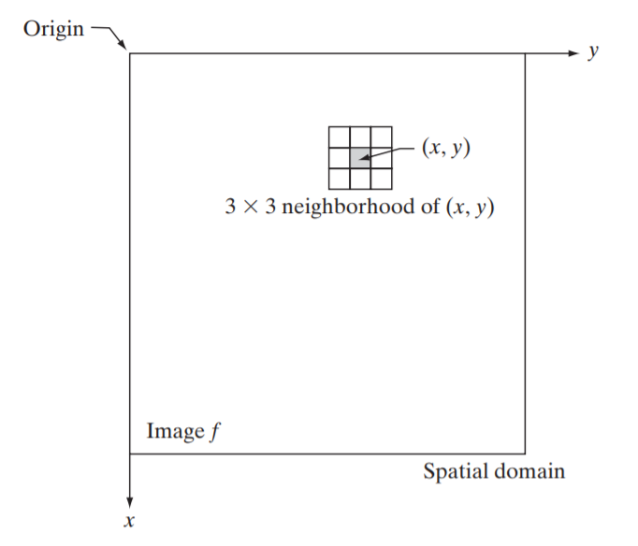
Image Transformations - Basics
The spatial domain processes can be denoted by the expression
g(x, y) = T[ f(x, y)]
Where f(x,y) is the input image, g(x,y) is the output image, and T is an operator on f defined over a neighborhood of point (x, y).
The point (x, y) shown is an arbitrary location in the image, and the small region shown containing the point is a neighborhood of (x, y),

Slide 4
Image Transformations - Basics
The process consists of moving the origin of the neighborhood from pixel to pixel and applying the operator T to the pixels in the neighborhood to yield the output at that location.
Typically, the process starts at the top left of the input image and proceeds pixel by pixel in a horizontal scan, one row at a time.
When the origin of the neighborhood is at the border of the image, part of the neighborhood will reside outside the image.
The procedure is either to ignore the outside neighbors in the computations specified by T, or to pad the image with a border of 0s or some other specified intensity values.
The procedure just described is called spatial filtering, in which the neighborhood, along with a predefined operation, is called a spatial filter (also referred to as a spatial mask, kernel, template, or window).

Slide 5
Image Transformations - Basics
The smallest possible neighborhood is of size 1X1. In this case, g depends only on the value of f at a single point (x, y) and T in becomes an intensity (also called gray-level or mapping) transformation function of the form –
s = T(r)
where, s and r are variables denoting the intensity of g and f at any point (x, y) respectively.

Slide 6
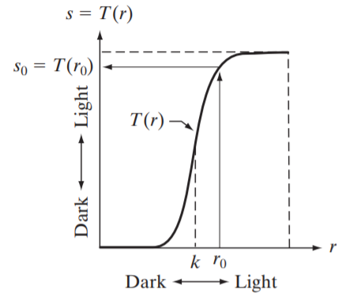
Intensity Transformation- Contrast stretching function
The effect of applying the transformation to every pixel of f to generate the corresponding pixels in g would be to produce an image of higher contrast than the original by darkening the intensity levels below k and brightening the levels above k.
In this technique, sometimes called contrast stretching, values of r lower than k are compressed by the transformation function into a narrow range of s, toward black.
The opposite is true for values of r higher than k.
Observe how an intensity value r₀ is mapped to obtain the corresponding value s₀

Slide 7
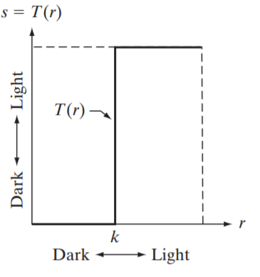
Intensity Transformation- Thresholding function
In the limiting case, T(r) produces a two-level (binary) image.
A mapping of this form is called a thresholding function.

Slide 8
Some Basic Intensity Transformation Functions
Intensity transformations are among the simplest of all image processing techniques. The values of pixels, before and after processing, will be denoted by r and s, respectively.
these values are related by an expression of the form s = T(r) where T is a transformation that maps a pixel value r into a pixel value s.
As an introduction to intensity transformations, which shows three basic types of functions used frequently for image enhancement:
linear (negative and identity transformations),
logarithmic (log and inverse-log transformations),and
power-law (nth power and nth root transformations). T

Slide 9
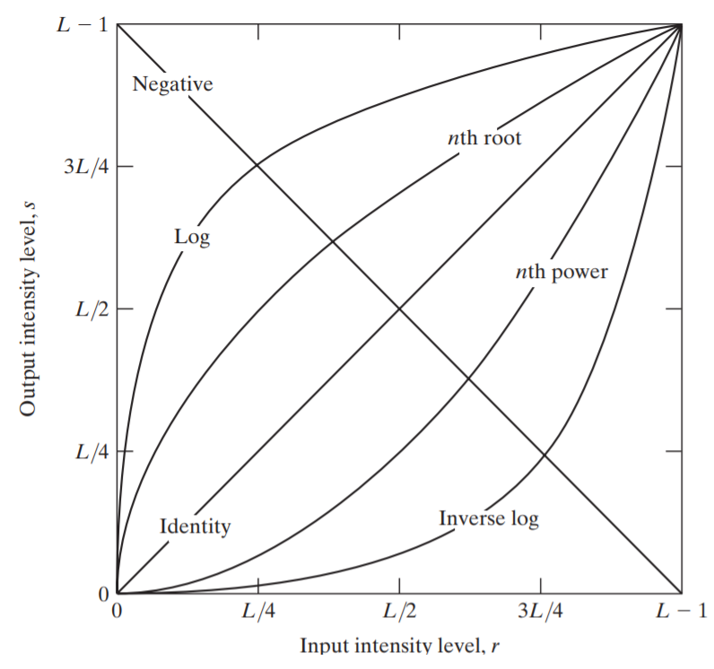
Image Negatives
The negative of an image with intensity levels in the range is obtained by using the negative transformation which is given by the expression-
s = L - 1 – r
Reversing the intensity levels of an image in this manner produces the equivalent of a photographic negative.
This type of processing is particularly suited for enhancing white or gray detail embedded in dark regions of an image, especially when the black areas are dominant in size.

Slide 10
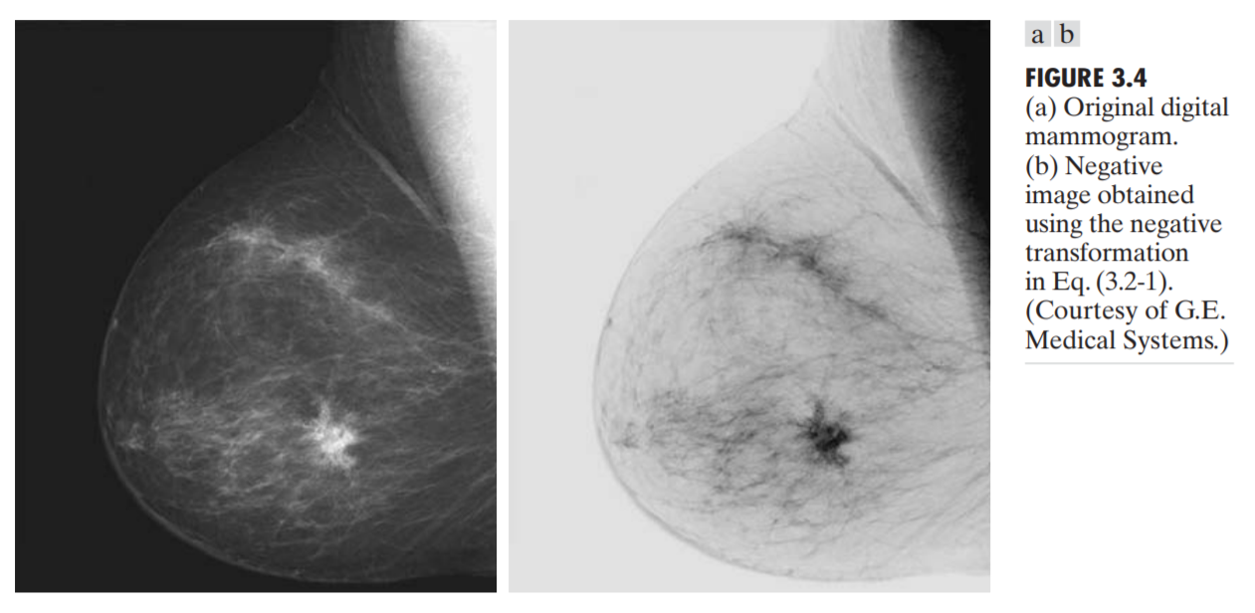
Image Negatives

Slide 11
Log Transformations
The general form of the log transformation is-
s = c log(1 + r)
where c is a constant, and it is assumed that r≥0
The shape of the log curve shows that this transformation maps a narrow range of low intensity values in the input into a wider range of output levels.
The opposite is true of higher values of input levels.
We use a transformation of this type to expand the values of dark pixels in an image while compressing the higher-level values. The opposite is true of the inverse log transformation.
The log function has the important characteristic that it compresses the dynamic range of images with large variations in pixel values.

Slide 12
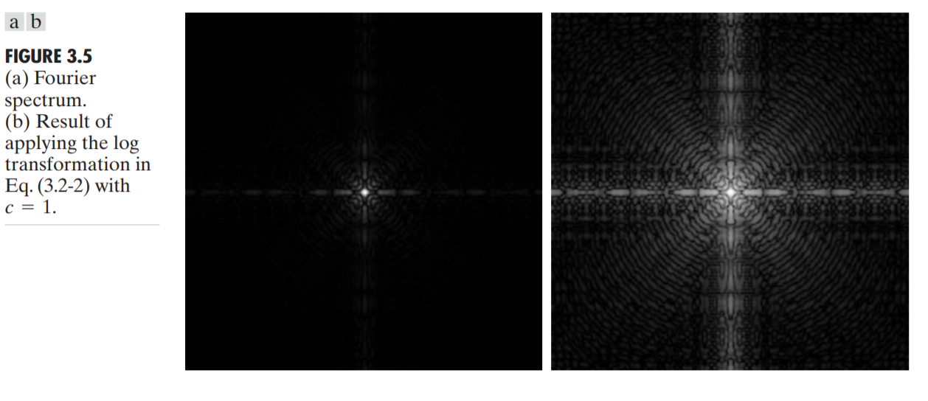
Log Transformations

Slide 13
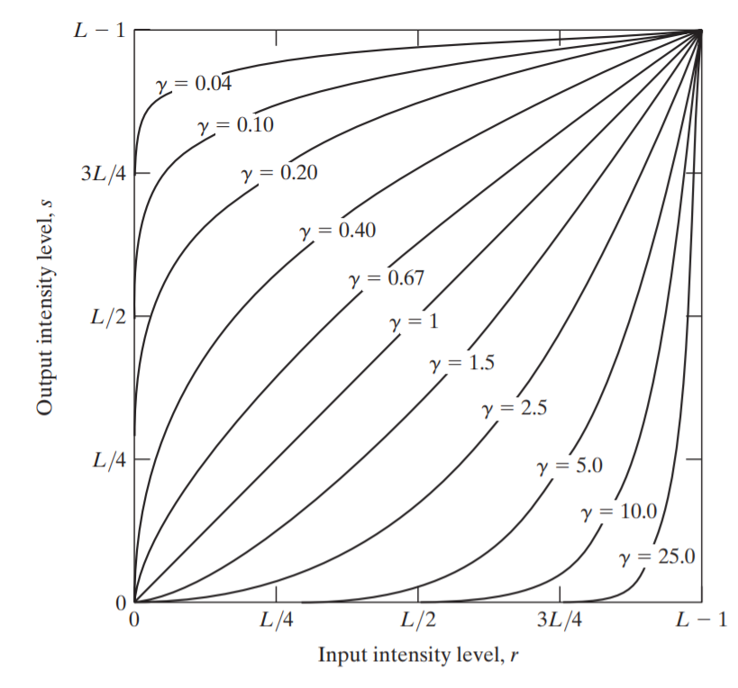
Power-Law (Gamma) Transformations
Power-law transformations have the basic form-
s = cr^{γ}
where c and γ are positive constants.
Power-law curves with fractional values of γ map a narrow range of dark input values into a wider range of output values, with the opposite being true for higher values of input levels.
curves generated with values of γ >1 have exactly the opposite effect as those generated with values of γ <1
It reduces to the identity transformation when c= γ=1
Plots of the equation s = cr^{γ} for various values of γ (c=1 in all cases.

Slide 14
Power-Law (Gamma) Transformations
Gamma correction controls the overall brightness of an image.
A variety of devices used for image capture, printing, and display respond according to a power law.
By convention, the exponent in the power-law equation is referred to as gamma,
The process used to correct these power-law response phenomena is called gamma correction.
For example, cathode ray tube (CRT) devices have an intensity-to-voltage response that is a power function, with exponents varying from approximately 1.8 to 2.5
With reference to the curve for γ=2.5, we see that such display systems would tend to produce images that are darker than intended

Slide 15
Gamma correction
Almost every computer monitor, from whatever manufacturer, has one thing in common.
They all have a intensity to voltage response curve which is roughly a 2.5 power function.
this just means that if you send your computer monitor a message that a certain pixel should have intensity equal to x, it will actually display a pixel which has intensity equal to x ^ 2.5 Because the range of voltages sent to the monitor is between 0 and 1, this means that the intensity value displayed will be less than what you wanted it to be.
(0.5 ^ 2.5 = 0.177 for example) Monitors, then, are said to have a gamma of 2.5

Slide 16
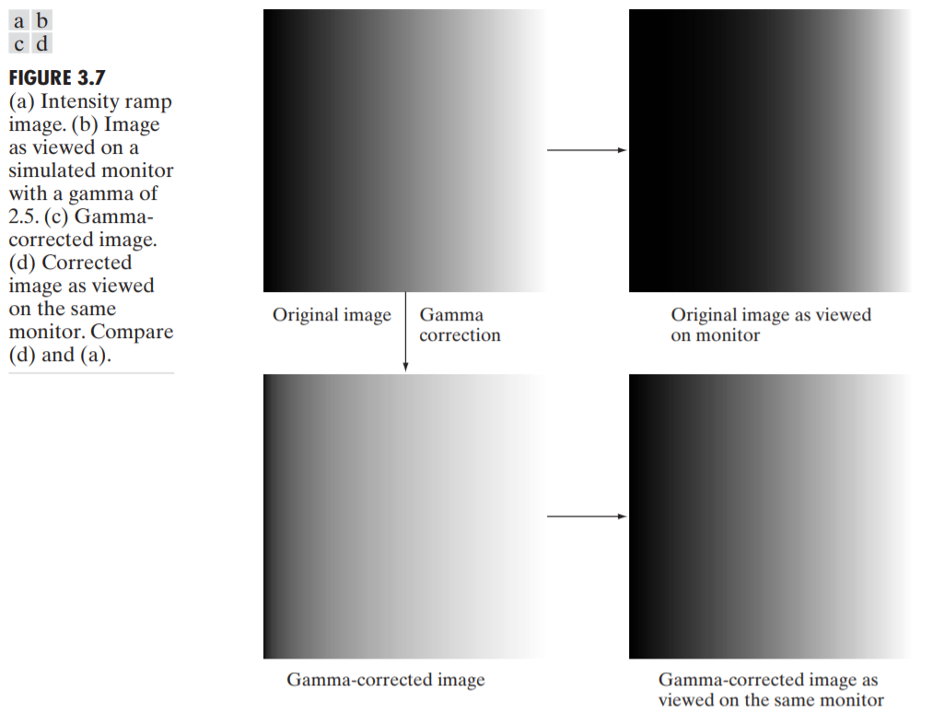
Gamma correction
As expected, the output of the monitor appears darker than the input, as Fig. 3.7(b) shows.
Gamma correction in this case is straightforward.
All we need to do is preprocess the input image before inputting it into the monitor by performing the transformation-
s = r^{1/2.5} = r^{0.4}
Images that are not corrected properly can look either bleached out or too dark.

Slide 17
Piecewise-Linear Transformation Functions
Contrast stretching-
One of the simplest piecewise linear functions is a contrast-stretching transformation.
Low-contrast images can result from poor illumination, lack of dynamic range in the imaging sensor, or even the wrong setting of a lens aperture during image acquisition.
Contrast stretching is a process that expands the dynamic range of intensity levels in an image so that it spans the full intensity range of the recording medium or display device.
Contrast is the difference between the highest gray level and low grey level of the image.

Slide 18
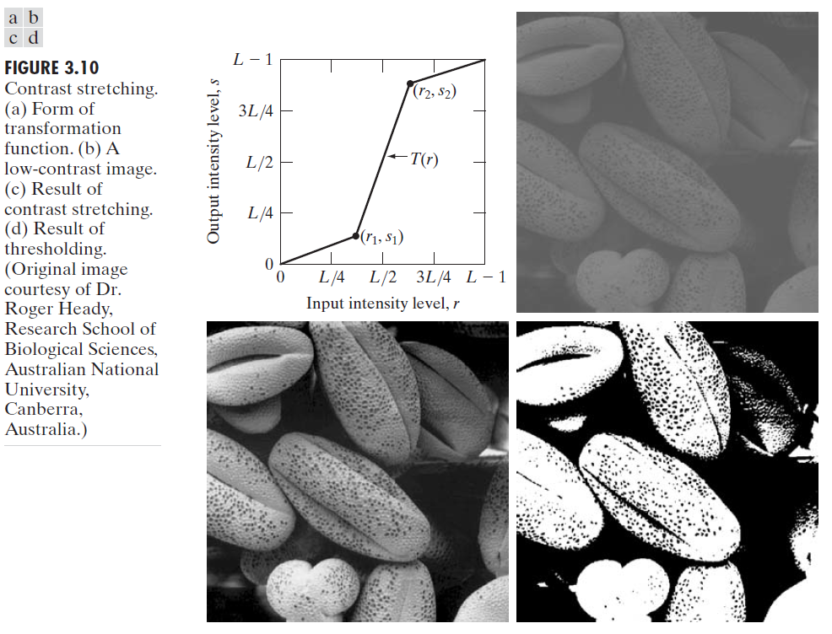
Piecewise-Linear Transformation - Contrast stretching-
The locations of points (r₁, s₁) and (r₂, s₂) control the shape of the transformation function.
If r₁ = s₁ and r₂ = s₂ the transformation is a linear function that produces no changes in intensity levels.
If r₁ = r₂ , s₁ =0 and s₂= L-1 the transformation becomes a thresholding function that creates a binary image, as illustrated in Fig. 3.2(b).
Intermediate values of (r₁, s₁) and (r₂, s₂) produce various degrees of spread in the intensity levels of the output image, thus affecting its contrast.

Slide 19
Piecewise-Linear Transformation - Contrast stretching-
The values are rescaled according to the input and output limits, low_in and high_in, and low_out and high_out respectively. The first pair sets the lower and upper limits on the input image, values above and below them being clipped. The second pair sets the lower and upper limits for the output image, the interval to which the image will be scaled after clipping the input limits.
imadjust (img, [0.3; 0.9], [0; 1])

Slide 20
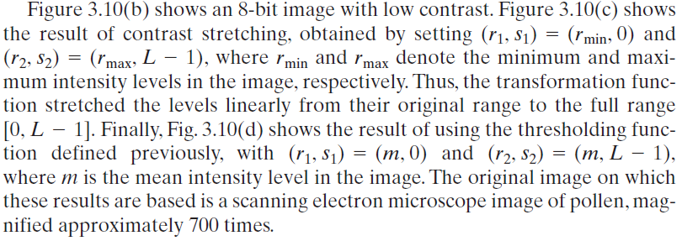
Piecewise-Linear Transformation - Contrast stretching-

Slide 21
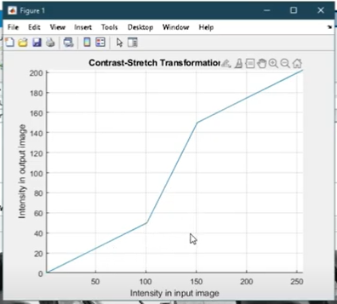

Slide 22
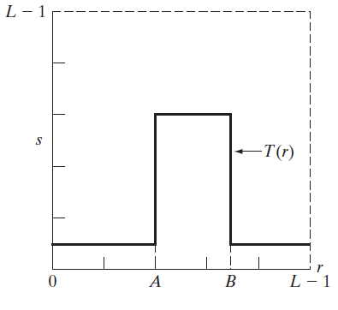
Piecewise-Linear Transformation - Intensity-level slicing
Highlighting a specific range of intensities in an image often is of interest.
Applications include enhancing features such as masses of water in satellite imagery and enhancing flaws in X-ray images.
The process, often called intensity-level slicing, can be implemented in several ways, but most are variations of two basic themes.
One approach is to display in one value (say, white) all the values in the range of interest and in another (say, black) all other intensities. This transformation, shown in Fig. produces a binary image.
This transformation highlights intensity range [A, B] and reduces all other intensities to a lower level.

Slide 23
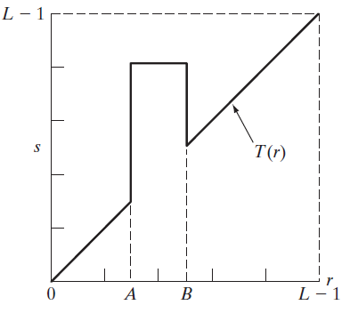
Piecewise-Linear Transformation - Intensity-level slicing
The second approach, based on the transformation in Fig. brightens (or darkens) the desired range of intensities but leaves all other intensity levels in the image unchanged.
This transformation highlights range [A, B] and preserves
all other intensity levels.

Slide 24
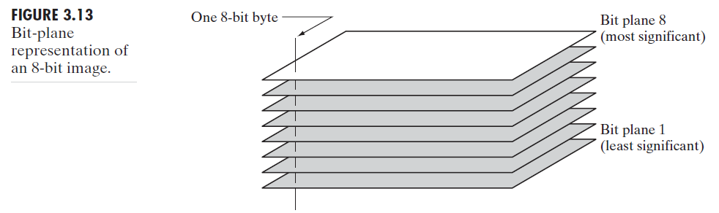
Piecewise-Linear Transformation Bit-plane slicing
Pixels are digital numbers composed of bits. For example, the intensity of each pixel in a 256-level gray-scale image is composed of 8 bits (i.e., one byte).
Instead of highlighting intensity-level ranges, we could highlight the contribution made to total image appearance by specific bits.
As Fig. 3.13 illustrates, an 8-bit image may be considered as being composed of eight 1-bit planes, with plane 1 containing the lowest-order bit of all pixels in the image and plane 8 all the highest-order bits.

Slide 25
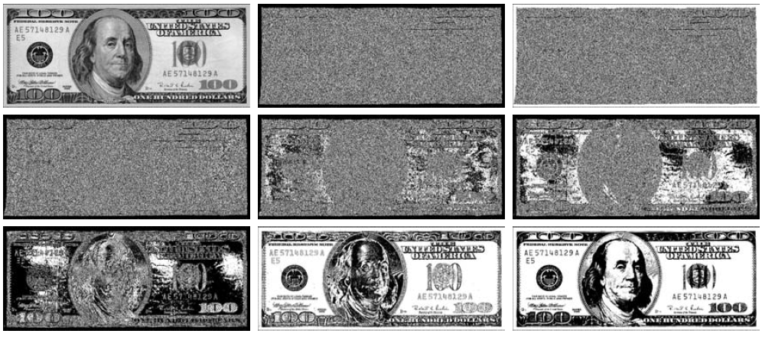

Bit –Plane Slicing
Figure 3.14(a) shows an 8-bit gray-scale image and Figs. 3.14(b) through (i) are its eight 1-bit planes, with Fig. 3.14(b) corresponding to the lowest-order bit.
Observe that the four higher-order bit planes, especially the last two, contain a significant amount of the visually significant data.
The lower-order planes contribute to more subtle intensity details in the image.
FIGURE 3.14 (a) An 8-bit gray-scale image of size 500 X 1192 pixels. (b) through (i) Bit planes 1 through 8, with bit plane 1 corresponding to the least significant bit. Each bit plane is a binary image.

Slide 26
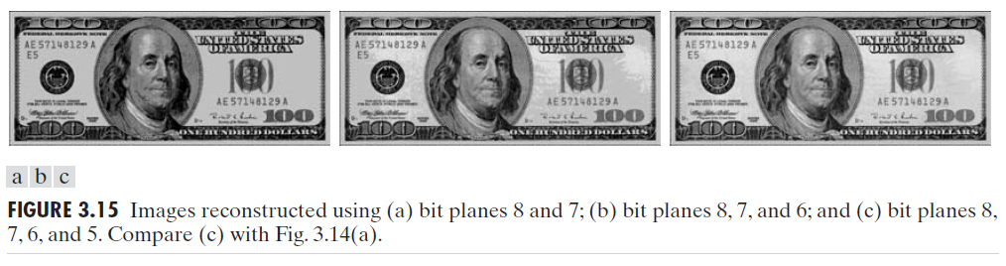
Bit –Plane Slicing
Decomposing an image is useful for image compression, in which fewer than all planes are used in reconstructing an image.
For example, Fig. 3.15(a) shows an image reconstructed using bit planes 8 and 7. The reconstruction is done by multiplying the pixels of the nth plane by the constant 2^{n-1}.
Each plane used is multiplied by the corresponding constant, and all planes used are added to obtain the gray scale image.
Thus, to obtain Fig. 3.15(a), we multiplied bit plane 8 by 128, bit plane 7 by 64, and added the two planes.

Slide 27
Problem Solving
Find all the bit planes of the following image-
140
A=[167 133 111
144 140 135
159 154 148]
2⁷ | 2⁶ | 2⁵ | 2⁴ | 2³ | 2² | 2¹ | 2⁰
1 | 0 | 0 | 0 | 1 | 1 | 0 | 0

Slide 28
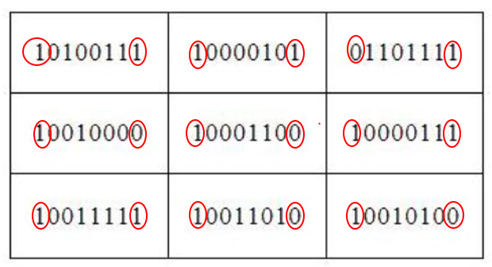
Solution -1st and 8th Bit- Plane
1 | 1 | 1
0 | 0 | 1
1 | 0 | 0
1st Bit- Plane
1 | 1 | 0
1 | 1 | 1
1 | 1 | 1
8th Bit- Plane

Slide 29
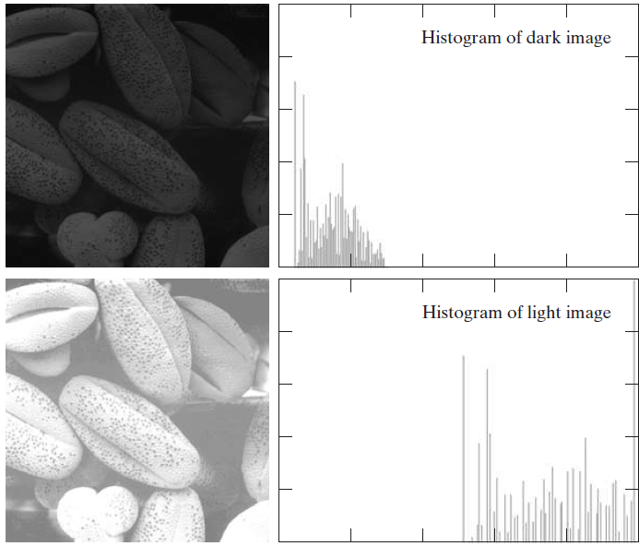
Histogram Processing
The histogram of a digital image with intensity levels in the range [0, L-1] is a discrete function h(r_{k}) = n_{k} where r_{k} is the kth intensity value and n_{k} is the number of pixels in the image with intensity r_{k}.

Slide 30
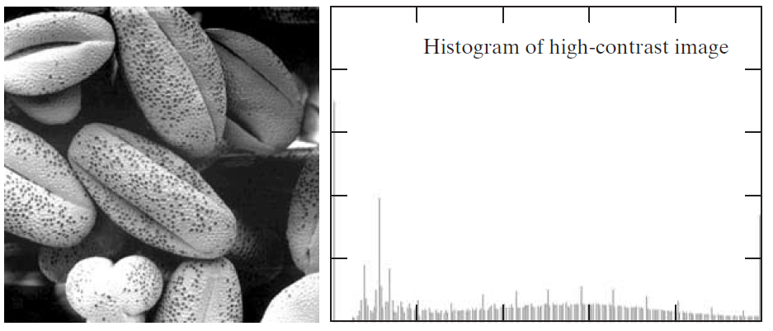
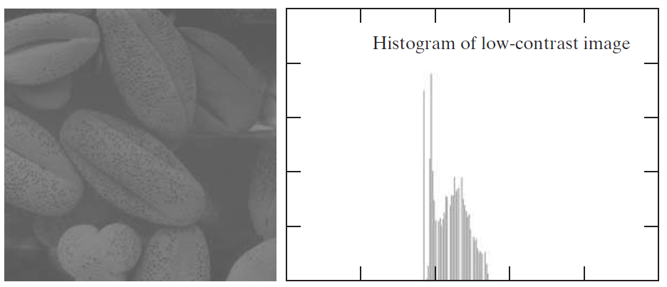
Histogram Processing
We see that the components of the histogram in the high-contrast image cover a wide range of the intensity scale and, further, that the distribution of pixels is not too far from uniform.
Intuitively, it is reasonable to conclude that an image whose pixels tend to occupy the entire range of possible intensity levels and, in addition, tend to be distributed uniformly, will have an appearance of high contrast and will exhibit a large variety of gray tones.

Slide 31
Histogram Processing
It is common practice to normalize a histogram by dividing each of its components by the total number of pixels in the image, denoted by the product MN, where, M and N are the row and column dimensions of the image.
Thus, a normalized histogram is given by p(r_{k}) = n_{k} /MN , for k = 0, 1, 2, A , L - 1.
p(r_{k}) is an estimate of the probability of occurrence of intensity level r_{k} in an image. The sum of all components of a normalized histogram is equal to 1.
The horizontal axis of each histogram plot corresponds to intensity values, r_{k}
The vertical axis corresponds to values of h(r_{k}) = n_{k} or p(r_{k}) = n_{k} /MN if the values are normalized.

Slide 32



Histogram Equalization
The probability of occurrence of intensity level in a digital image is approximated by –
Where MN is the total number of pixels in the image, n_{k} is the number of pixels that have intensity r_{k} and L is the number of possible intensity levels in the image (e.g., 256 for an 8-bit image).
The discrete form of the Histogram Equalization transformation is-
The transformation (mapping) T(r_{k}) in this equation is called a histogram equalization or histogram linearization transformation

Slide 33
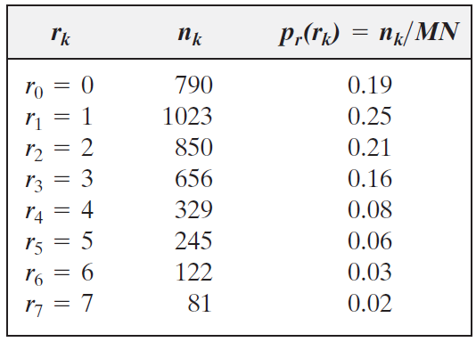

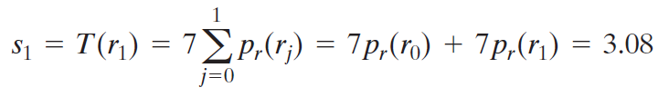
A simple illustration of histogram equalization
Suppose that a 3-bit image (L=8) of size 64X64 pixels (MN=4096) has the intensity distribution shown in the Table where the intensity levels are integers in the range [0, L - 1] = [0, 7].
Values of the histogram equalization transformation function are obtained –
And s₂ = 4.55, s₃ = 5.67, s₄ = 6.23, s₅ = 6.65, s₆ = 6.86, s₇ = 7.0
Intensity distribution and histogram values for a 3-bit, 64X64 digital image.

Slide 34
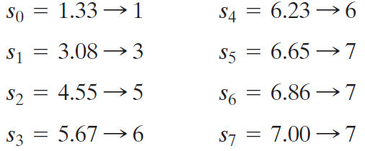
A simple illustration of histogram equalization
At this point, the s values still have fractions because they were generated by summing probability values, so we round them to the nearest integer:
These are the values of the equalized histogram. Observe that there are only five distinct intensity levels. Because r₀=0 was mapped to s₀ = 1. there are 790 pixels in the histogram equalized image with this value.
Also, there are in this image 1023 pixels with a value of s₁ = 3 and 850 pixels with a value of s₂ = 5.
However both r₃ and r₄ were mapped to the same value, 6, so there are (656 + 329) = 985 pixels in the equalized image with this value.
Similarly, there are (245 + 122 + 81) = 448 pixels with a value of 7 in the histogram equalized image

Slide 35
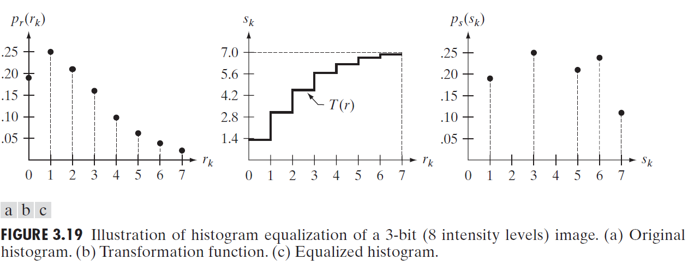
A simple illustration of histogram equalization

Slide 36
Practice Question
Perform Histogram equalization for the following image. Plot original and equalized histogram.
4 | 4 | 4 | 4 | 4
3 | 4 | 5 | 4 | 3
3 | 5 | 5 | 5 | 3
3 | 4 | 5 | 4 | 3
4 | 4 | 4 | 4 | 4
Probability
3- .24
4- .56
5 - .2
Intensity | Probability | New Mapping
3 | .24 | 1.68 | 2
4 | .56 | 3.92 | 4
5 | .2 | 1.4 | 1

Slide 37
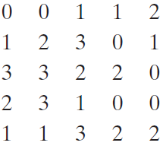
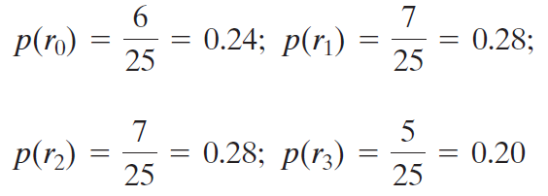
Computing histogram statistics
Consider the following 2-bit image of size 5X5
The pixels are represented by 2 bits; therefore, L=4 and the intensity levels are in the range [0, 3].The total number of pixels is 25, so the histogram has the components-
where the numerator in p(r_{i}) is the number of pixels in the image with intensity level r_{i}

Slide 38
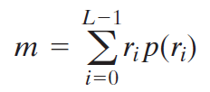
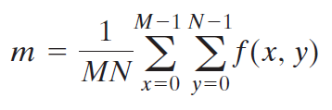
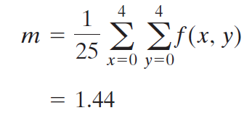
Computing histogram statistics
Compute the average value of the intensities in the image using-
= (0)(0.24) + (1)(0.28) + (2)(0.28) + (3)(0.20)
= 1.44
Letting f(x, y) denote the preceding 5 X 5 array and using-
We obtain-

Slide 39
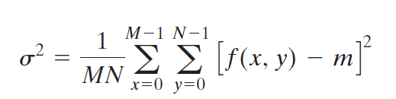
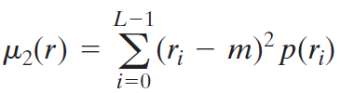
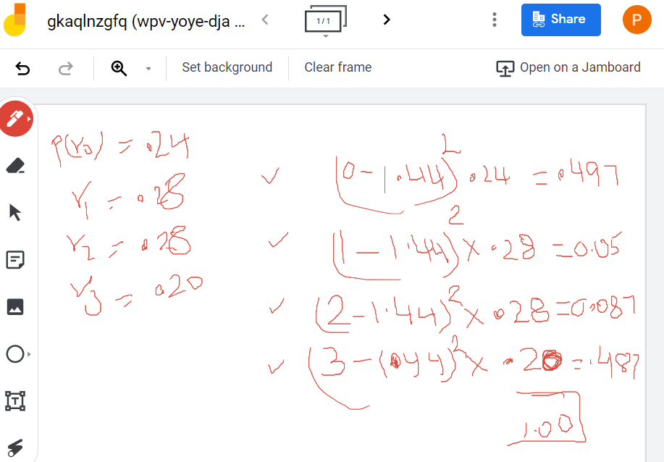
Computing histogram statistics
Similarly, the result for the variance is the same (1.1264) using the formula-
and
Calculating variance:
Probability | Variance
P(r₀) = 0.24 | (0-1.44)²x 0.24 =0.497
P(r₁) = 0.28 | (1-1.44)²x 0.28 =0.050
P(r₂) = 0.28 | (2-1.44)²x 0.28 =0.087
P(r₃) = 0.20 | (3-1.44)²x 0.20 =0.481
Total = 1.00 | Total = 1.115

Slide 40
Using Histogram Statistics for Image Enhancement
We consider two uses of the mean and variance for enhancement purposes
The global mean and variance are computed over an entire image and are useful for gross adjustments in overall intensity and contrast.
A more powerful use of these parameters is in local enhancement, where the local mean and variance are used as the basis for making changes that depend on image characteristics in a neighborhood about each pixel in an image.

Slide 41
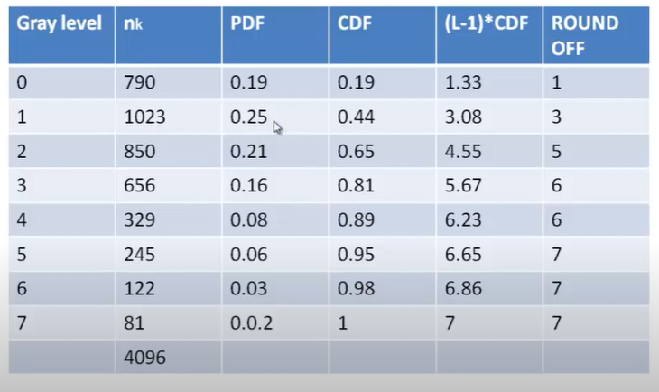

Slide 42
